Slide 1






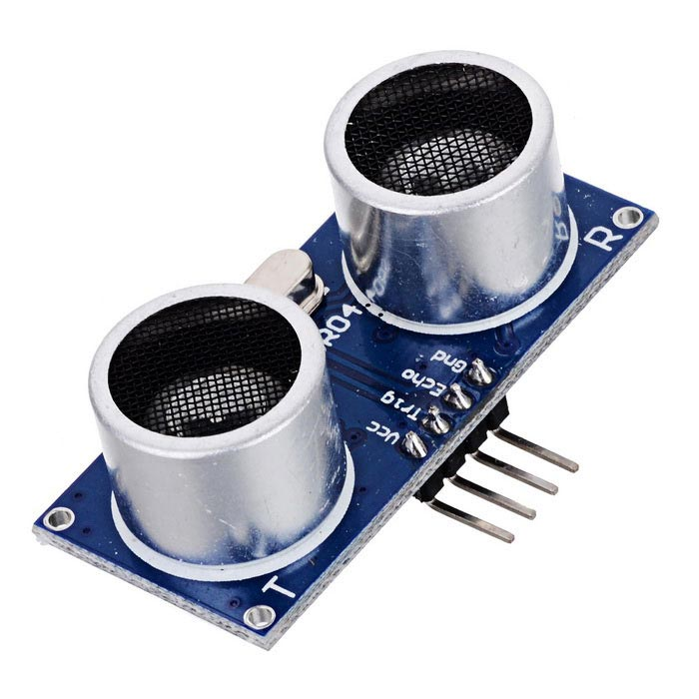
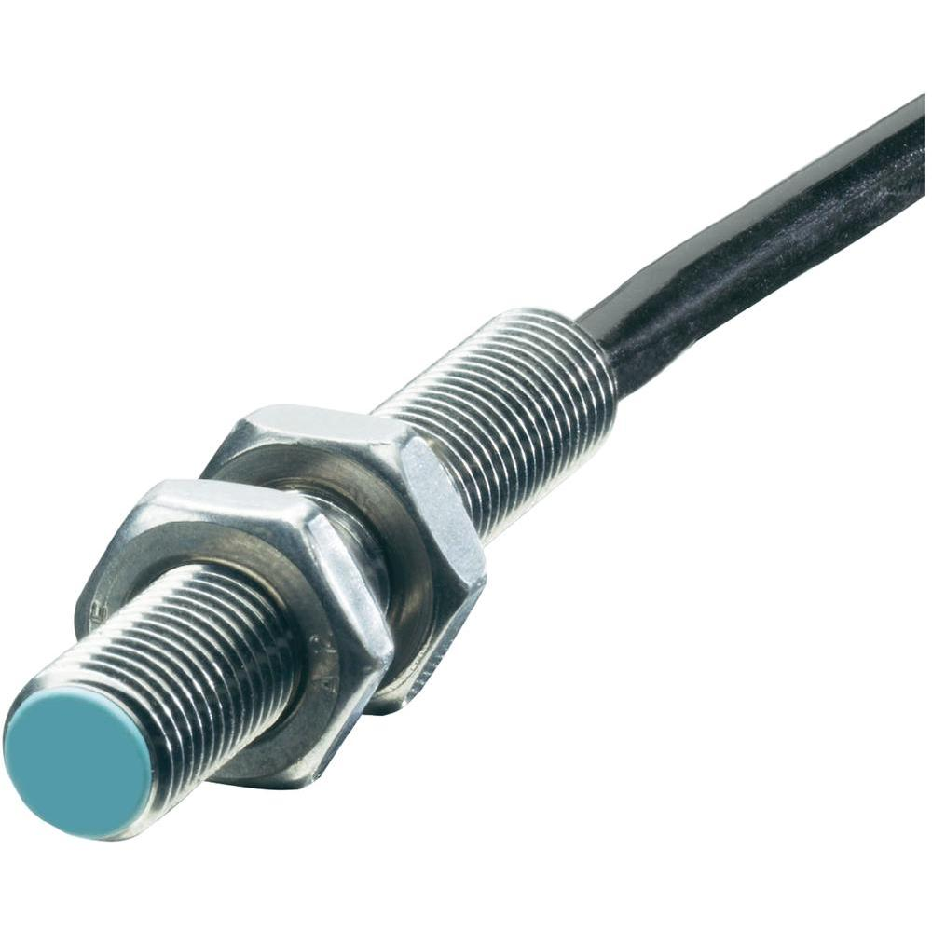
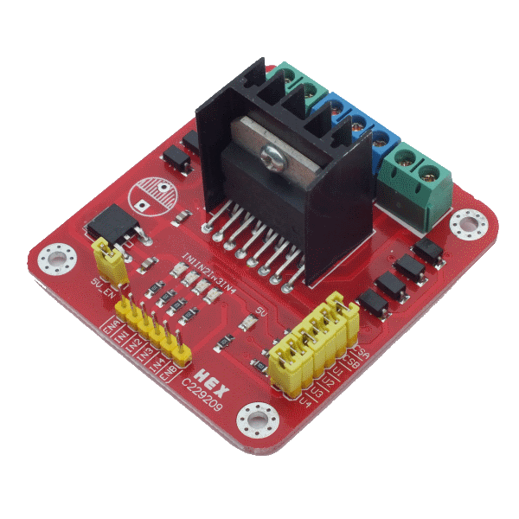
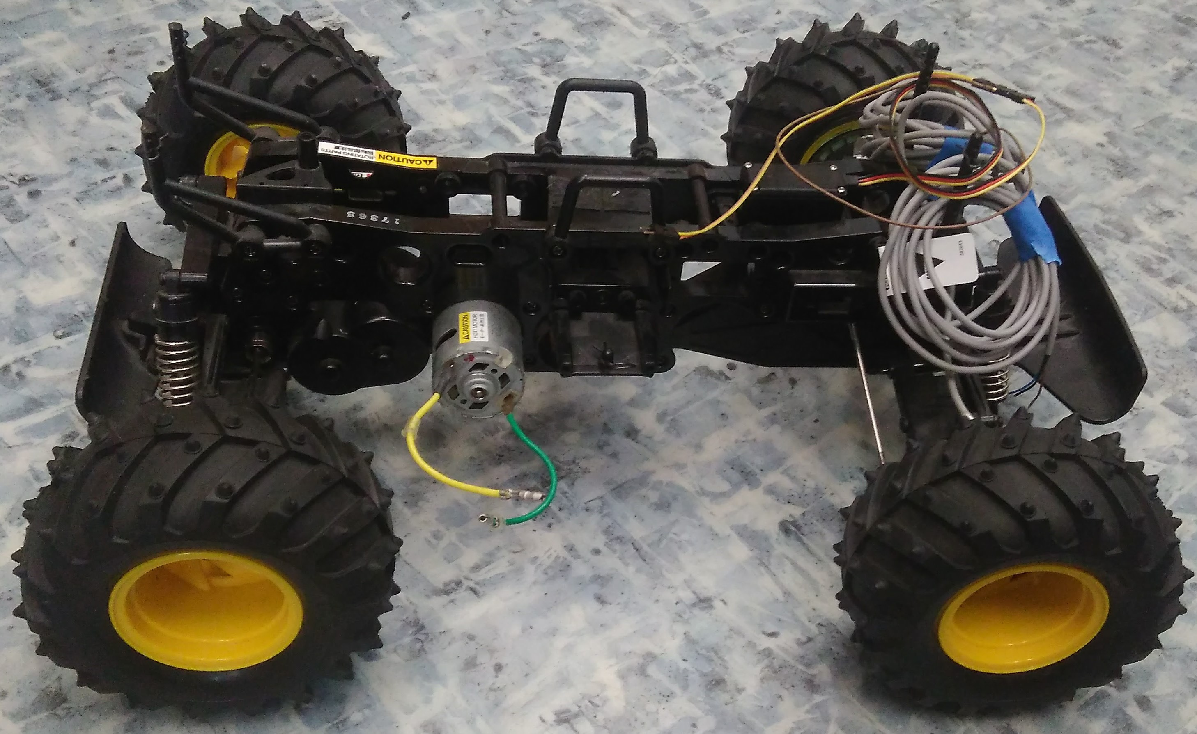
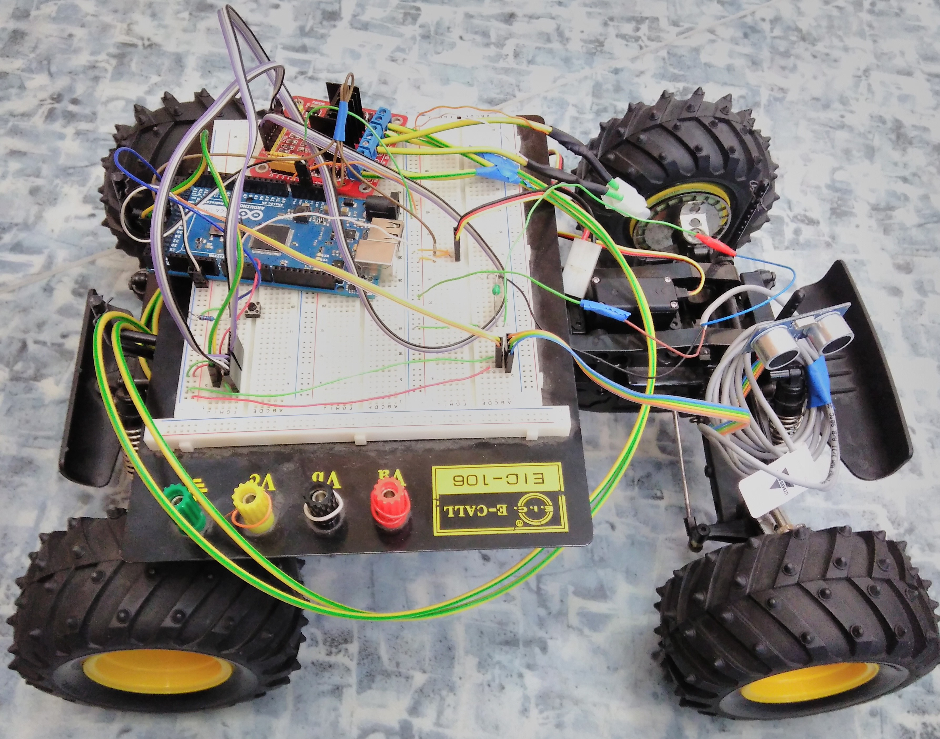
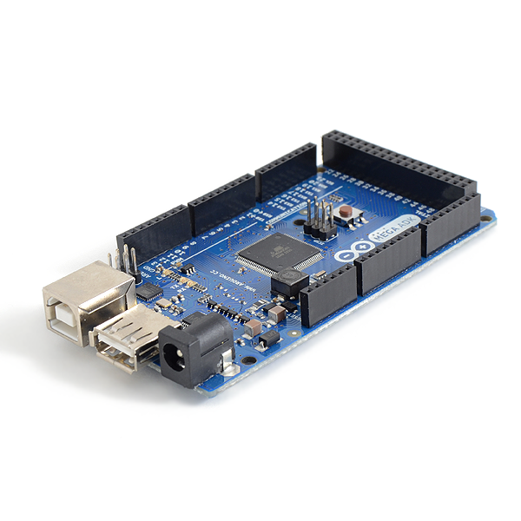
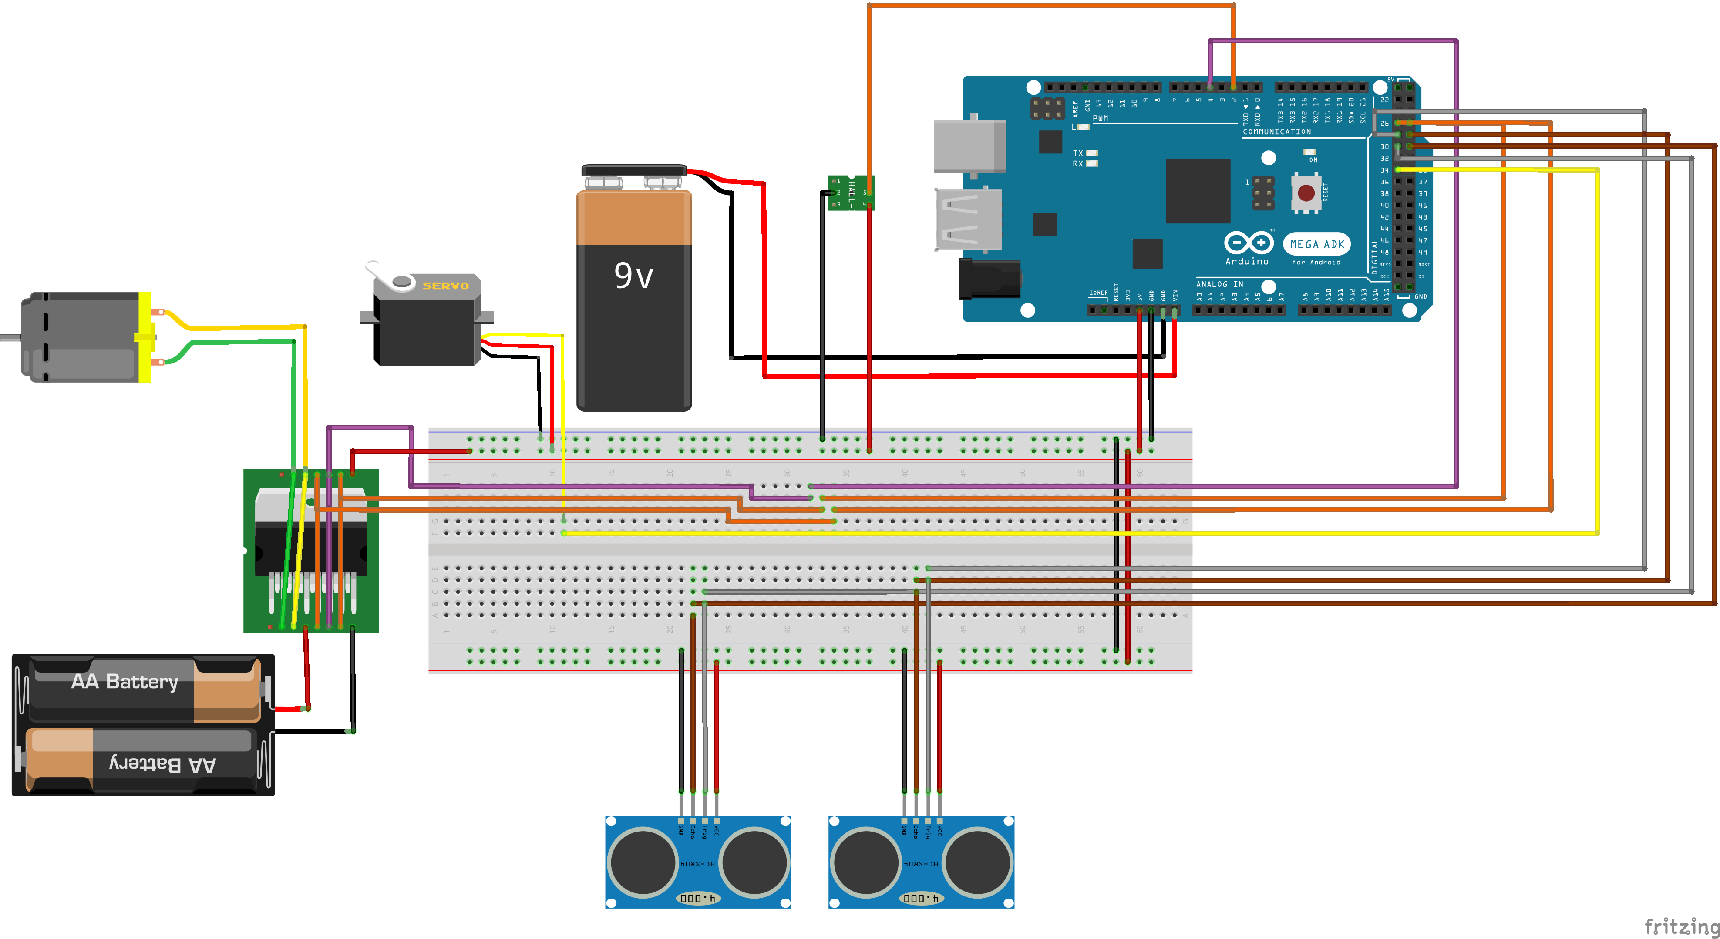
YOUR
PHOTO
HERE
NAME: Gabriel Almeida
SUPERVISOR: Martin Šipoš
CZECH UNIVERSITY:
Czech Technical University in Prague
CZECH DEPARTMENT:
Department of Measurement
BRAZILIAN UNIVERSITY:
Federal University of Bahia
Autonomous Car Parking
Introduction
With the increasing number of cars in our streets, the amount of crashes and accidents caused by human errors only grows. This brings the necessity to automate not only driving, but parking also, since most drivers have difficulty with parallel parking, which is the main type of parking that this project proposes to solve.
Goal
The main goal of this project is to develop the software and the hardware to parallel park a prototype car.
Figure 1. The prototype car with and without the hardware.
Figure 2. The hardware schematics.
Methodology
Step by step, the hardware of each actuator(motor and step motor) and each sensor(inductive sensor and ultrasonic sensor) were implemented and tested with simple programs, to verify their behavior alone, to only later put everything together to test their integration with each other and with the parking algorithm.
Figure 3. Ultrasonic sensor, inductive sensor and h-bridge.
Development
The first thing done in the project was the connection and testing of the motor with the h-bridge and the micro-controller. After having this primary part working, it was time to work on the sensors, starting with the ultrasonic sensor, and followed by the inductive sensors. The next step was to connect the servo motor to steer the car in the desired direction. Since the project is still ongoing until march 30th, the algorithm is what is being worked on now, and after it is done and optimized, all the hardware will be moved from the breadboard to a perfboard, so it is more compact and fail proof, since there won’t be many detachable connections as in the breadboard that is currently being used for testing.
Figure 4. Arduino Mega ADK board.
Results and conclusion
The autonomous parking is a real world problem that needs a solution, in this project it was noted that it is hard to solve but it is possible. In a few months it was possible to develop the hardware and software to do it in small scale, and the knowledge gathered from it could be used to implement it on real cars. It is a technology already in production in some companies, but it is far from being perfect and fail proof, there is lots of room for improvements. Until the end of the project a paper will be written so all the knowledge gathered from it can be shared and used by future students that wants to do something similar, possibly leading to bigger projects and improving everyday life in the streets.
PRAGUE – FEBRUARY 2017
ACADEMIC EXCHANGE PROGRAM
BRAZIL – CZECH REPUBLIC
INSTITUTE OF CZECH-BRAZILIAN ACADEMIC COOPERATION - www.incbac.org - www.unigou.org

